Slide 1
IBMQ QForest

Slide 2
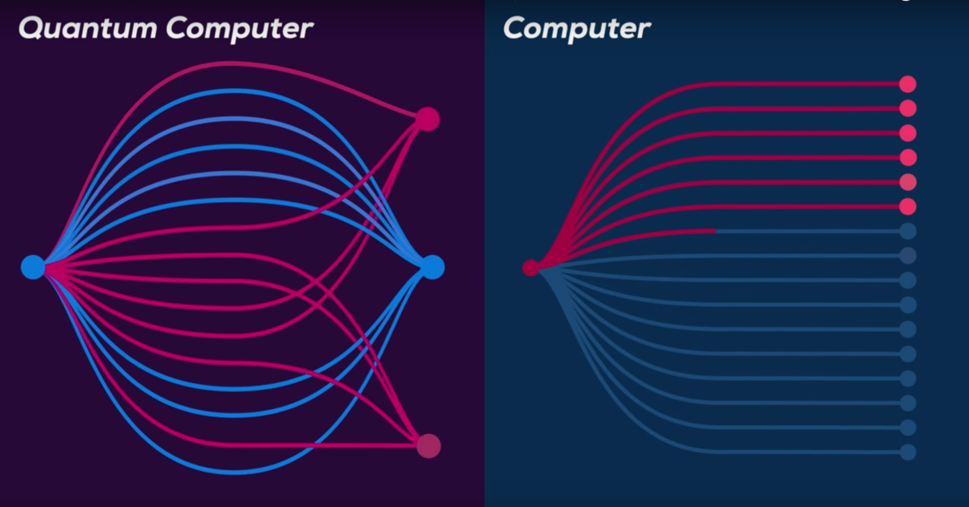
The Quantum Way
A classical computation is like a solo voice — one line of pure tones succeeding each other. A quantum computation is like a symphony — many lines of tones interfering with one another. ― Seth Lloyd

Slide 3
Superposition
Want to create your own quantum circuit? Toss a coin!

Slide 4
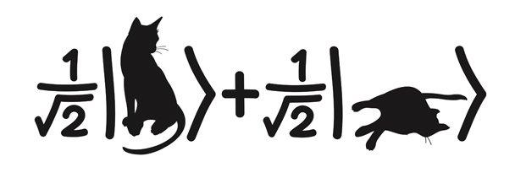
Superposition

Slide 5

Entanglement

